Slide 1
CUSTOMIZING GUIDE WOOCOMMERCE
Responsible of Document: Olivier CHANTHASENG, Elisa FAUCI
Author: Samira MHAMSA 02/11/2023

Slide 2
SUMMARY
How to create a product sheet
Category creation
Promotion code creation
Apply promotions
VAT management
Email personalization
Bundle creation procedure
Cross-sell creation procedure
Customer account creation/validation procedure
Ordering a product on Ekovya
Product search and addition to basket

Slide 3
1- Create a product sheet

Slide 4
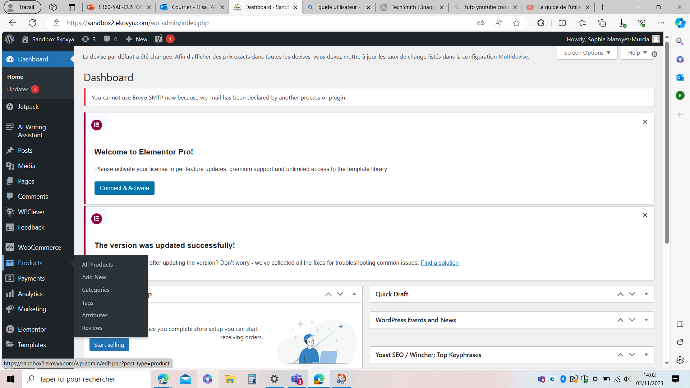
1- To select dashboard
2 - To select "products"
3 - To select "all products"

Slide 5
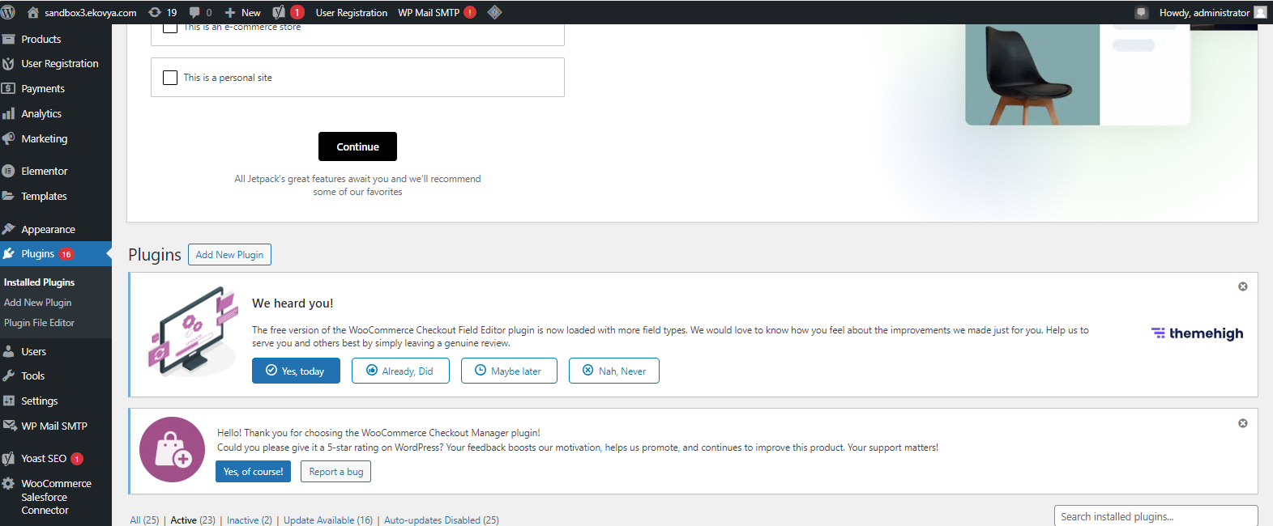

Slide 6
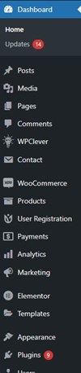
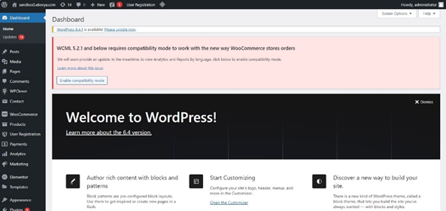

Slide 7
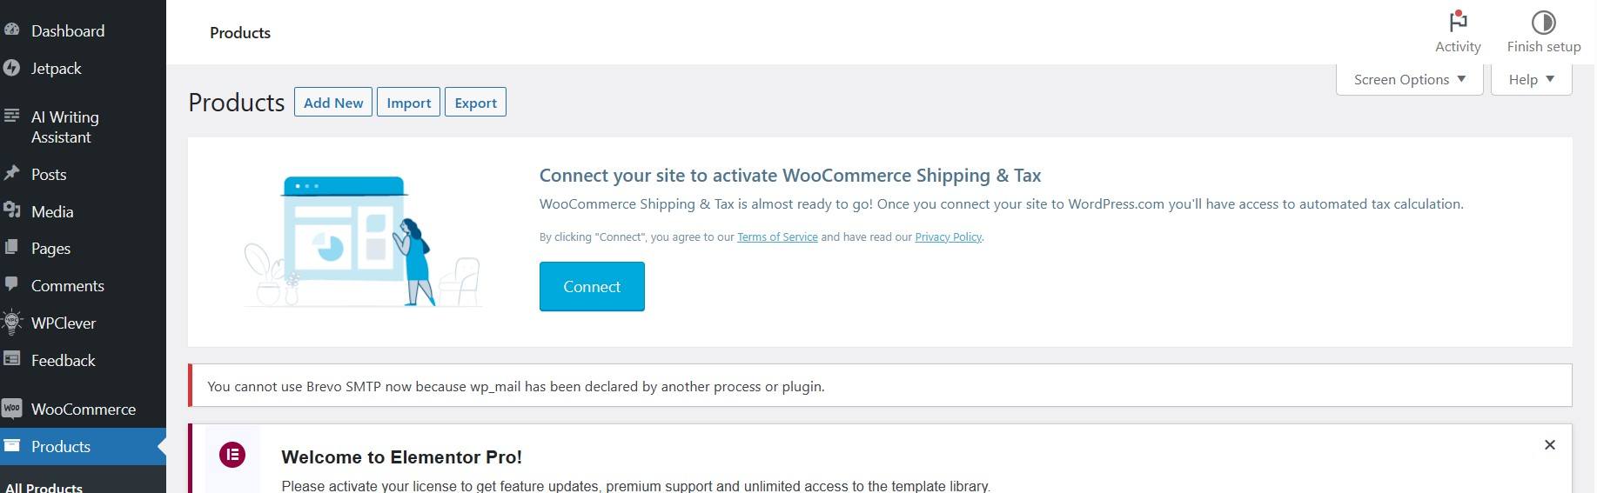
4- To clic on "add new"

Slide 8
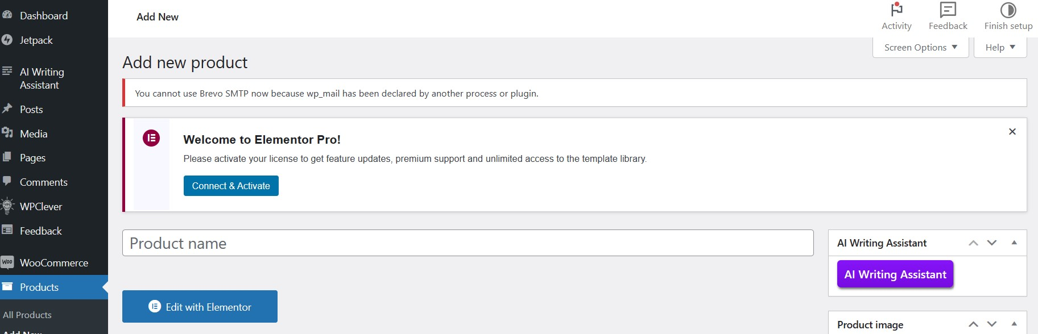
5- To put a product name

Slide 9
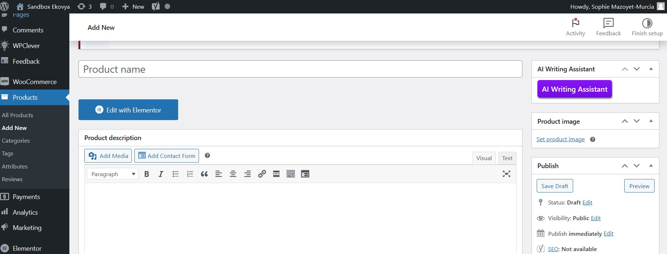
6 - To add text

Slide 10
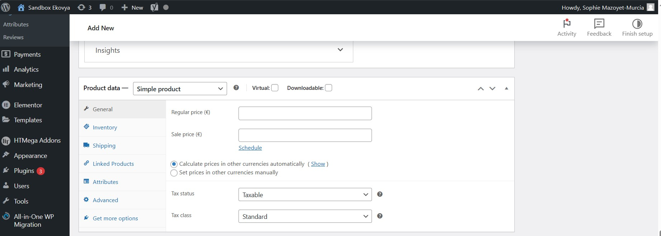
7- On the same page, scroll down and add general informations

Slide 11
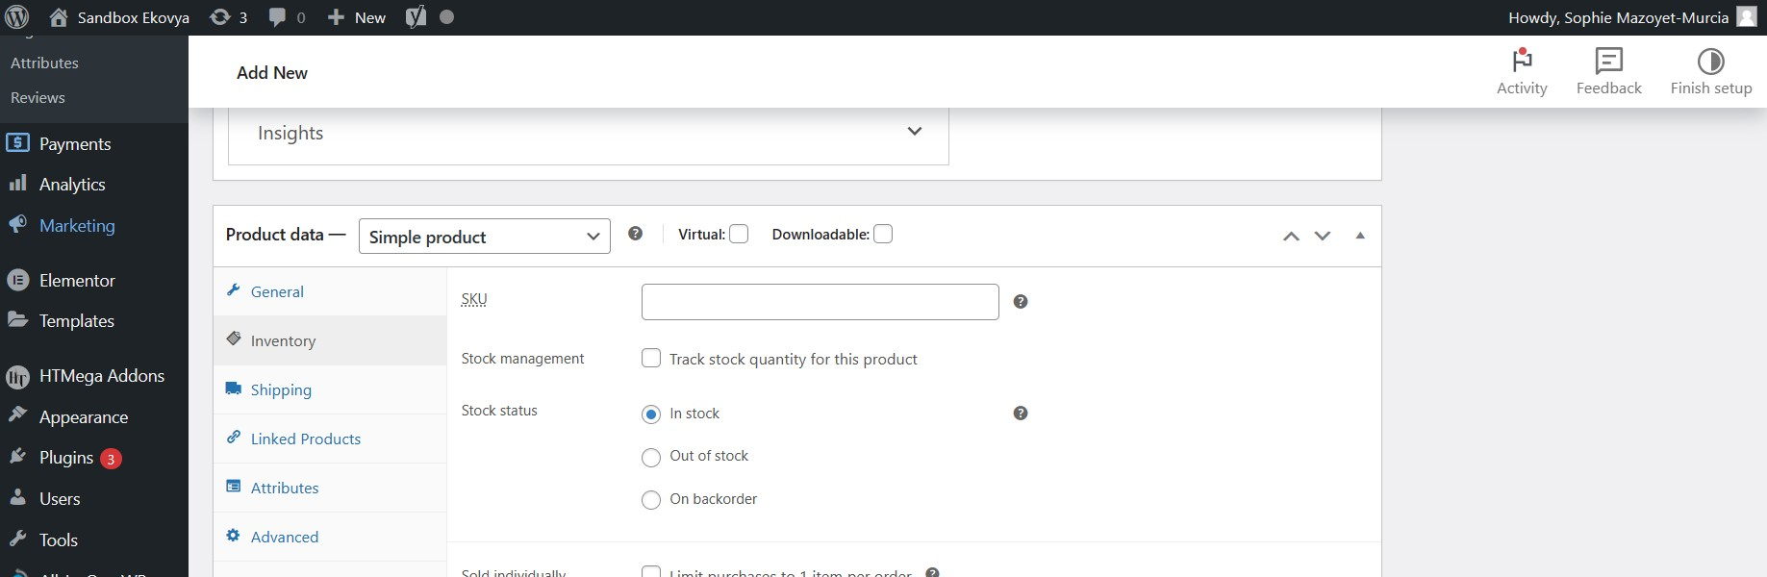
8- To add inventory informations

Slide 12
Add image

Slide 13
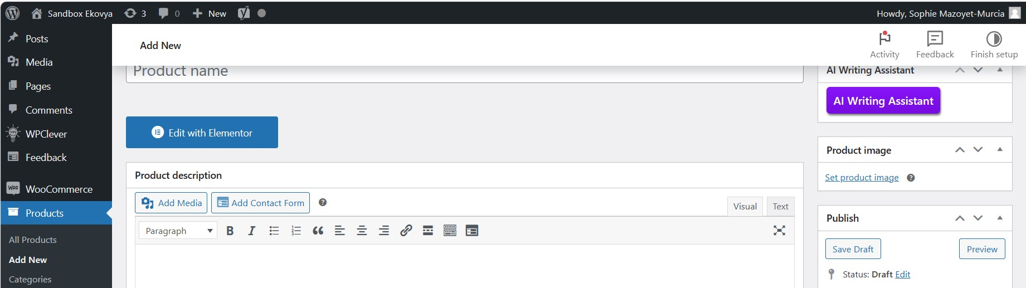
9- To clic on "set product image"

Slide 14
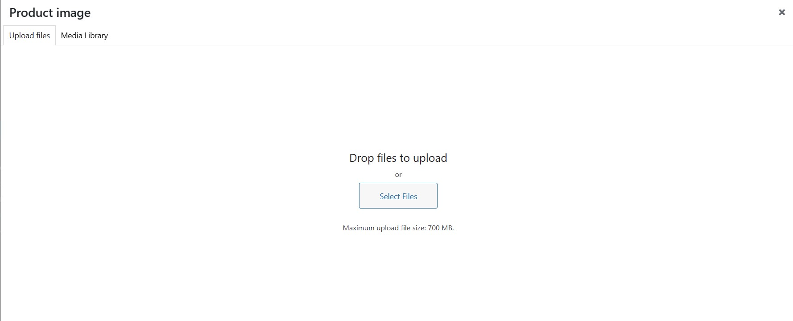
10- To clic on "upload files"
11- To clic on "select files"

Slide 15
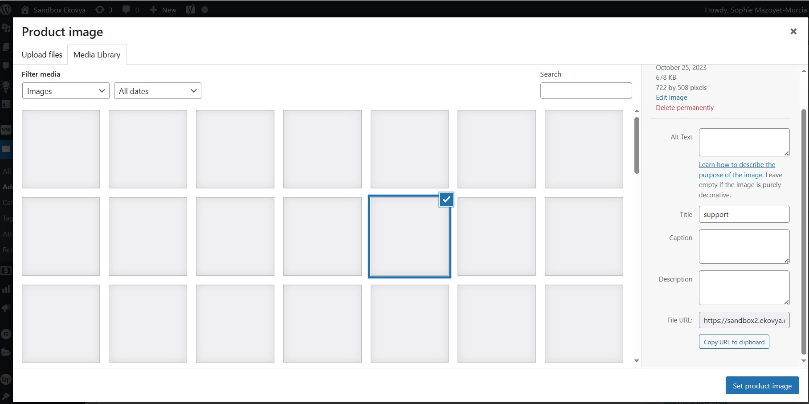
12 - Go on "media library"
13 - To clic on "upload files"
14 - To add "keys word"
15 - To clic on "set product image"

Slide 16
Add tags

Slide 17
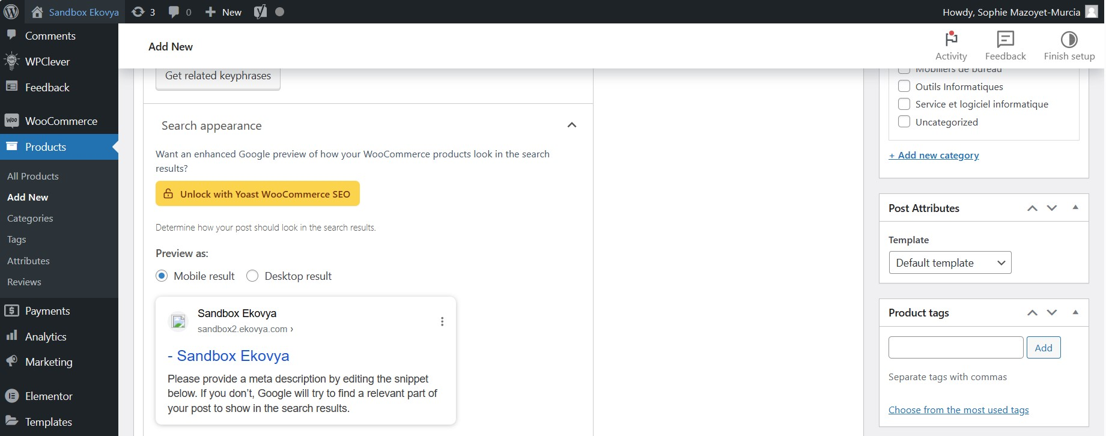
16 - To add some tags
17 – To clic on "add" tag

Slide 18
Add categorie

Slide 19
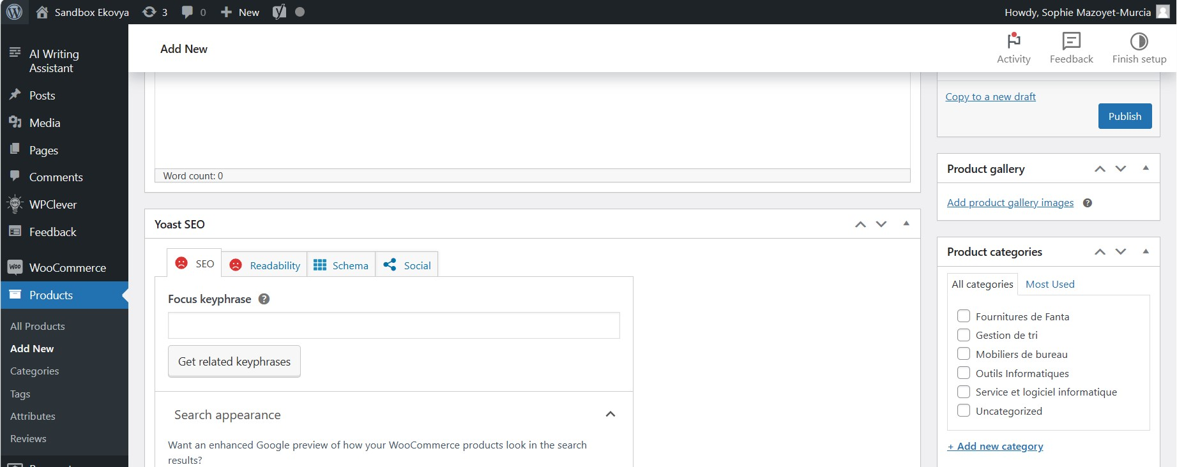
18 – To select categorie

Slide 20
2- Add new categorie

Slide 21
1 – To clic on "add new categorie"

Slide 22
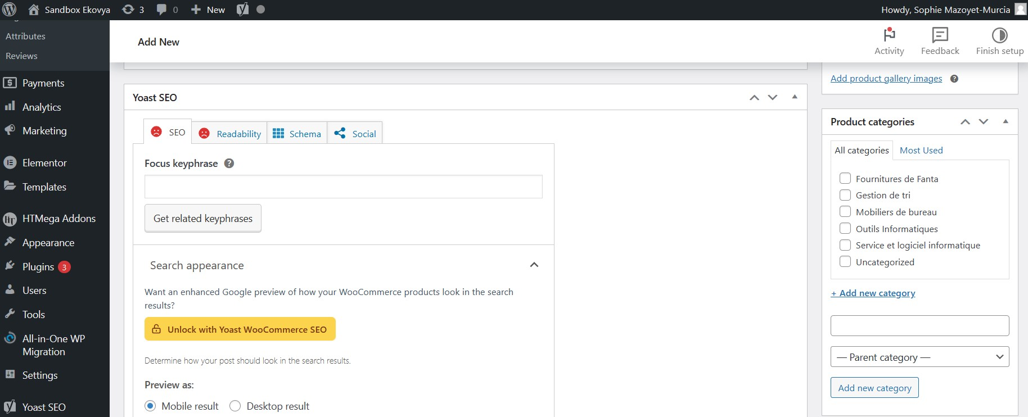
2 – To put categorie name's"
3 – To select "category parent"
4– To clic on "add new categorie"

Slide 23
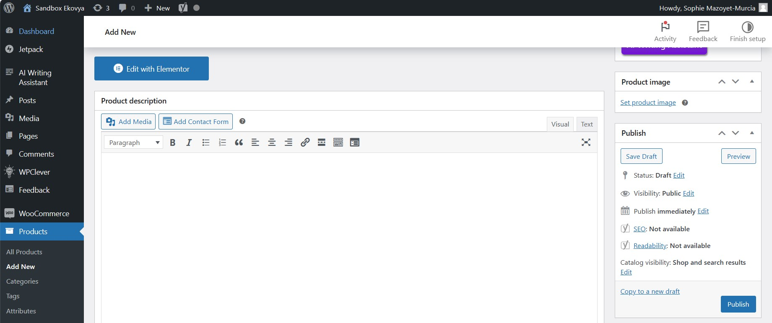
Click on "publish"

Slide 24
3- Promotion code creation

Slide 25
4- Apply promotion

Slide 26
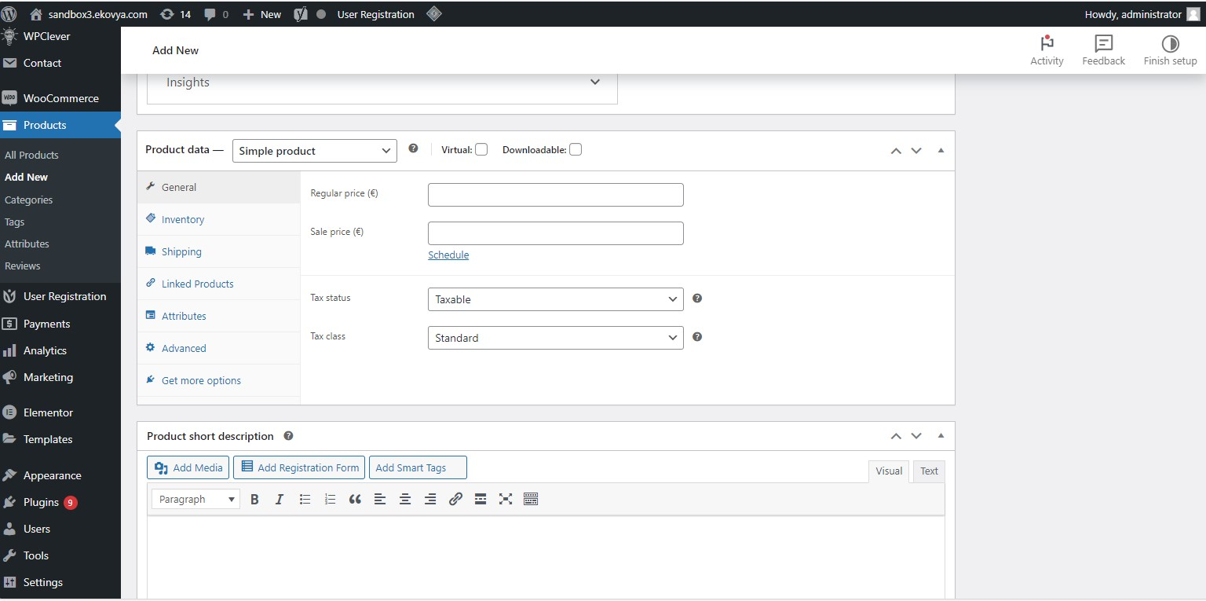
Click on "products"
Click on "general"
Click on "sales price"

Slide 27
5- VAT management

Slide 28
6- Email personalization

Slide 29
Click on "products"
Click on "general"
Click on "tax status"

Slide 30
6- Bundle creation procedure

Slide 31
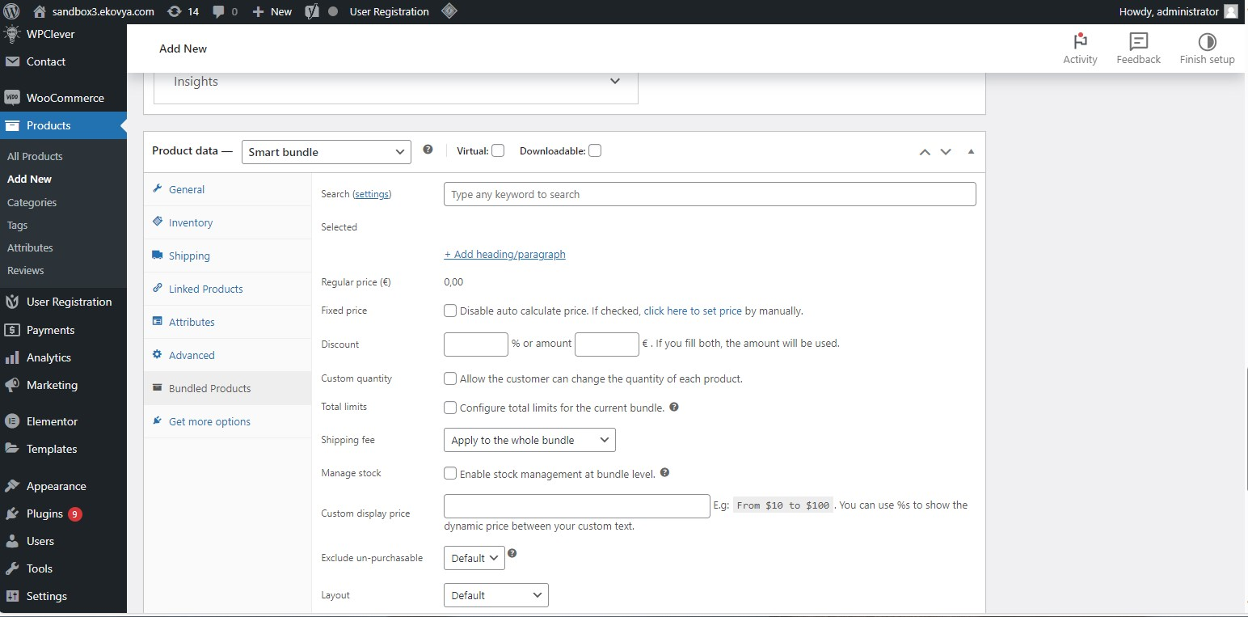
Click on "products"
Go to picklist and choose "smart bundle"
Clik on "bundled products"

Slide 32
7- Cross sell and up sells creation procedure

Slide 33
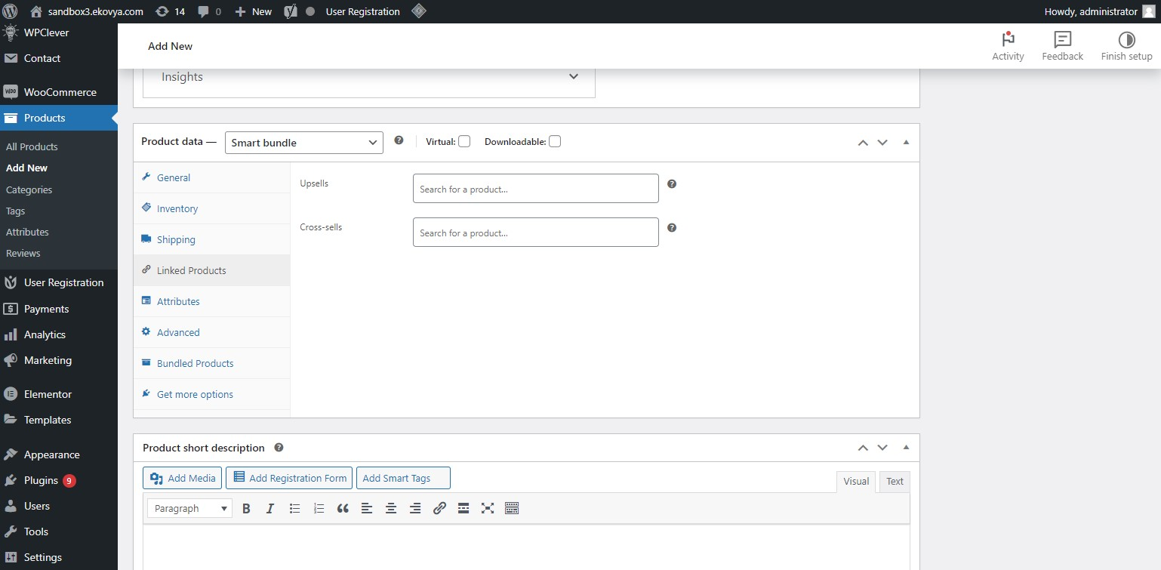

Slide 34
7- Customer account creation / validation procedure

Slide 35
7- Ordering a product on Ekovya

Slide 36
7- Products search and addition to basket

Slide 37
Thank you for your trust!
SIGMA360 – CRM ALPHA - 2023
Responsible of Document: Olivier CHANTHASENG
Author: Samira MHAMSA 02/11/2023

